Slide 1










ATAI
Advanced Techniqueof Artificial Intelligence
ATAI
ChongqingUniversity _{AdvancedTechniqueof}
of Technology Artificial Intelligence
Chongqing University of
Technology
Chongqing University ^{ATAI}
_{of Technology} Advanced Techniqueof
Artificial Intelligence
Chongqing University of Technology
Chongqing University of Technology
Enriching Semantic Profiles into Knowledge Graph for Recommender Systems Using Large Language Models
Code: https://github.com/circleAhn/SPiKE-pytorch
2026.3.1•ChongQing
—— KDD 2026
Reported by Shunan Yin
1
Notes:
用大模型丰富知识图谱的语义信息用于推荐系统

Slide 2

ATAI
AdvancedTechniqueof
Artificial Intelligence
ATAI
ChongqingUniversity _{AdvancedTechniqueof}
of Technology Artificial Intelligence
ChongqingUniversity of Technology
Motivation
1).KG-only models provide explicit links between users and items, but the specific attributes that users prefer remain implicit.
2).LLM-generated user profiles are explicit, but they are generally focused on the user, often limited to item coverage.
3).These methods confine profile signals to local user-item modeling, instead of propagating them throughout the entire KG.
Notes:
这些方法将语义文件信号限制为局部用户项建模，而不是在整个KG中传播

Slide 3

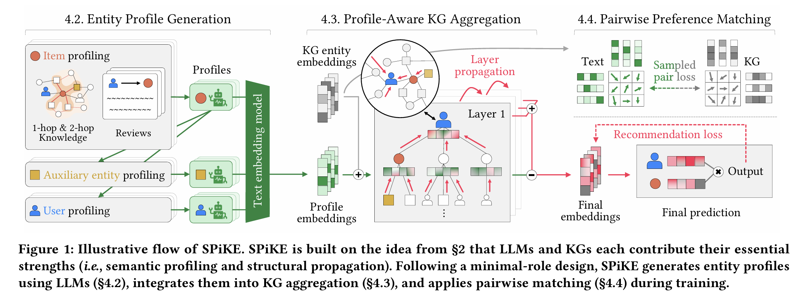
ChongqingUniversity of Technology
ATAI
AdvancedTechniqueof
Artificial Intelligence
ATAI
ChongqingUniversity _{AdvancedTechniqueof}
of Technology Artificial Intelligence
Overview

Slide 4
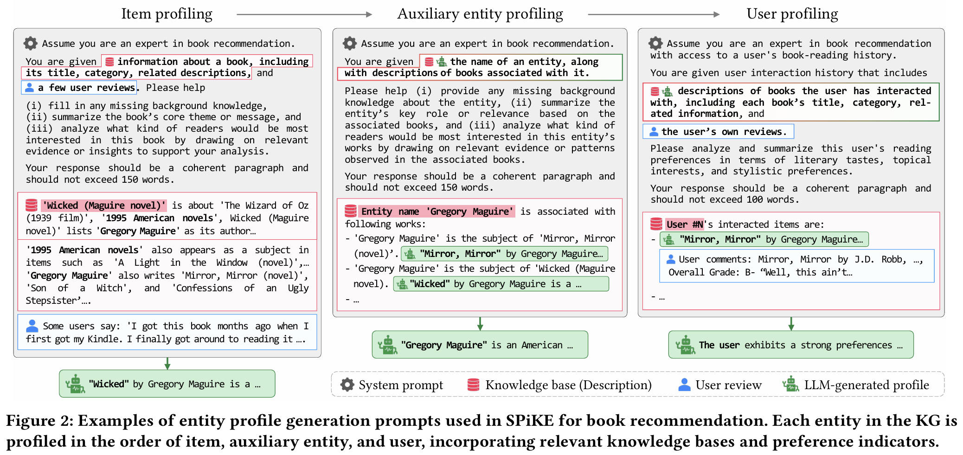
ChongqingUniversity of Technology
ATAI
AdvancedTechniqueof
Artificial Intelligence
ATAI
ChongqingUniversity _{AdvancedTechniqueof}
of Technology Artificial Intelligence
Overview

Slide 5

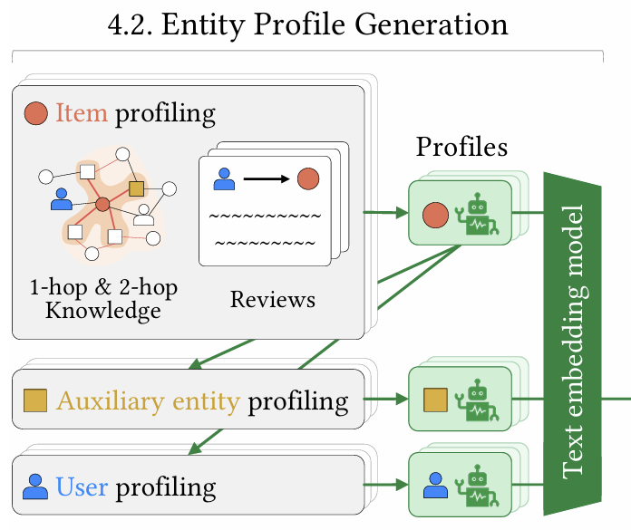
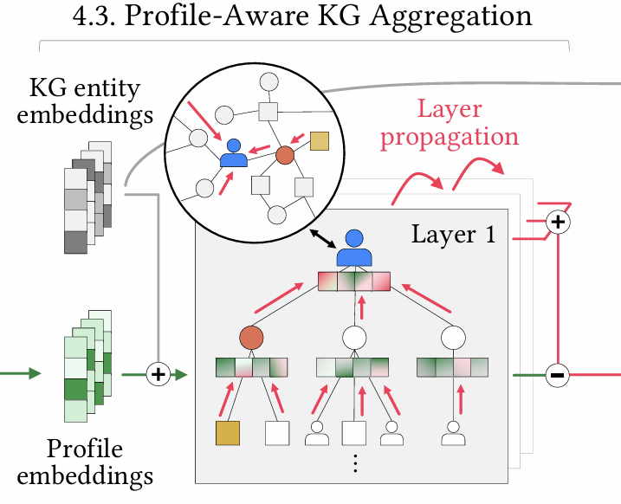
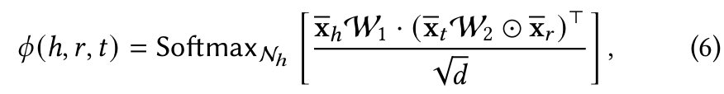
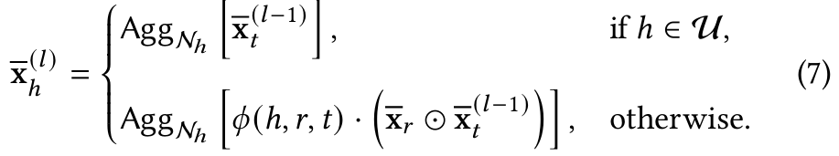
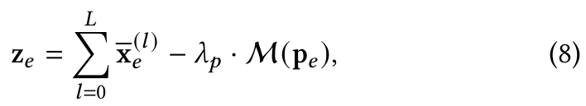
ChongqingUniversity of Technology
Method
ATAI
AdvancedTechniqueof
Artificial Intelligence
ATAI
ChongqingUniversity _{AdvancedTechniqueof}
of Technology Artificial Intelligence

Slide 6
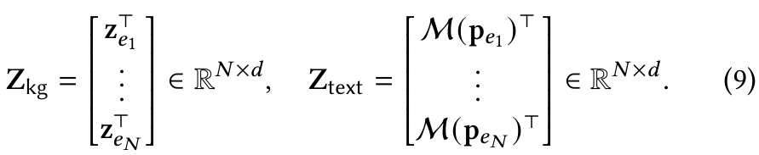
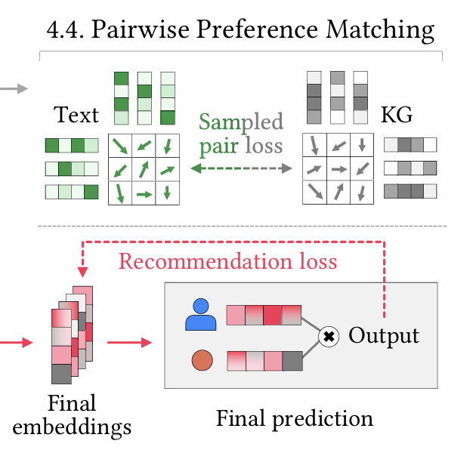


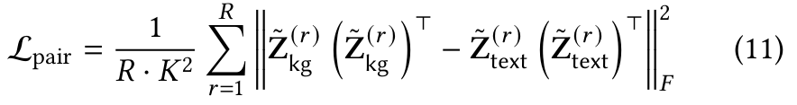

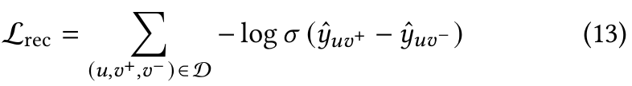
ChongqingUniversity of Technology
Method
ATAI
AdvancedTechniqueof
Artificial Intelligence
ATAI
ChongqingUniversity _{AdvancedTechniqueof}
of Technology Artificial Intelligence

Slide 7

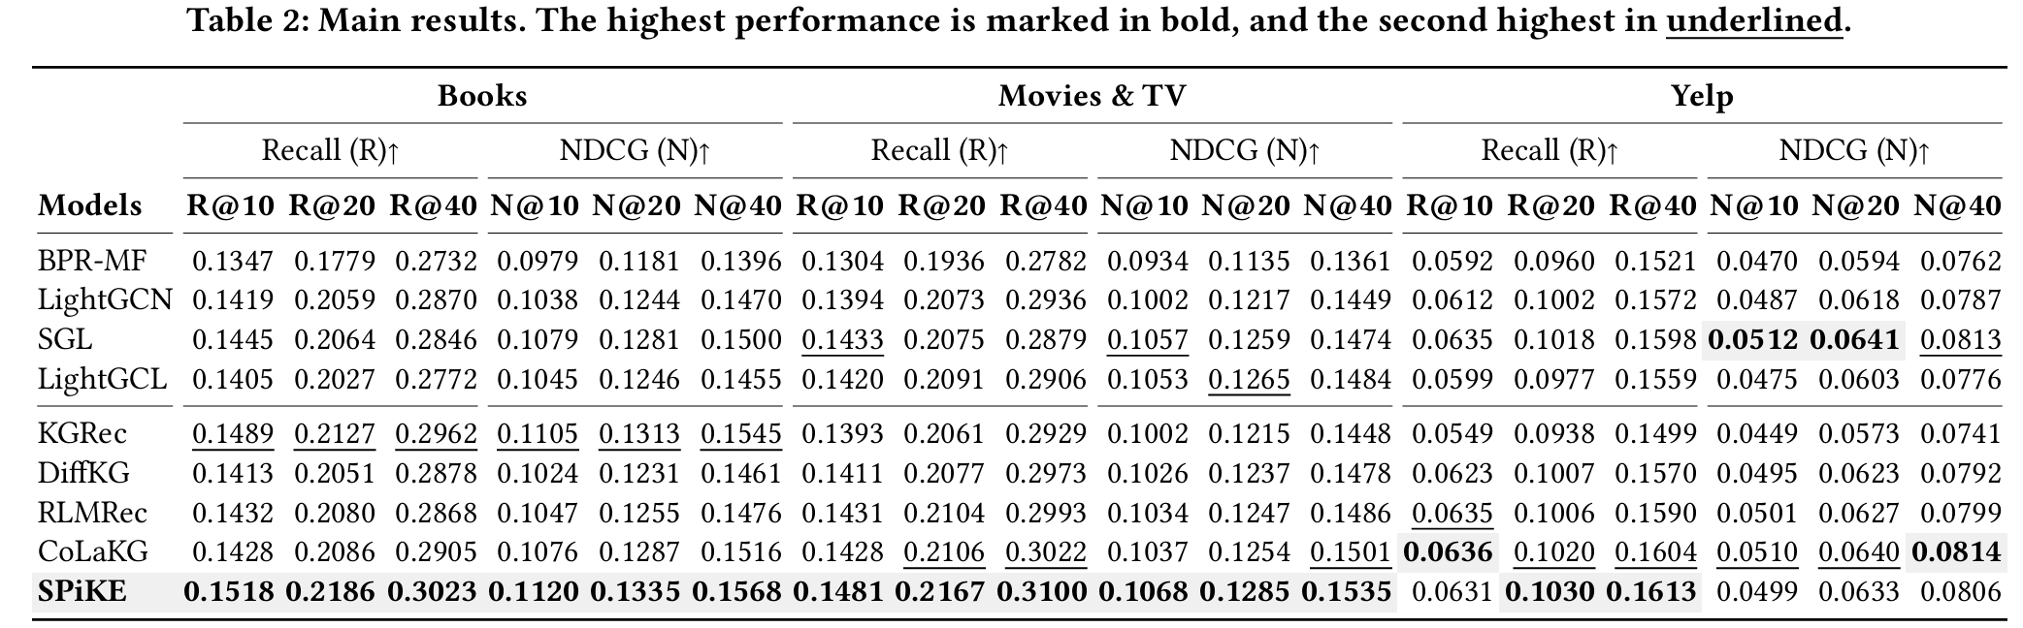
Experiments
ATAI
AdvancedTechniqueof
Artificial Intelligence
ATAI
ChongqingUniversity _{AdvancedTechniqueof}
of Technology Artificial Intelligence
ChongqingUniversity of Technology

Slide 8
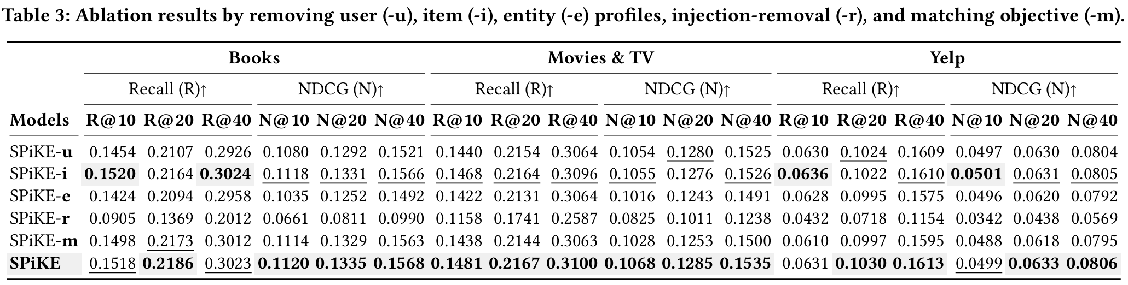
Experiments
ATAI
AdvancedTechniqueof
Artificial Intelligence
ATAI
ChongqingUniversity _{AdvancedTechniqueof}
of Technology Artificial Intelligence
ChongqingUniversity of Technology
Notes:
删除用户(Spike-u)、item(Spike-i)或实体(Spike-e)的profile
省略把语义信息注入到知识图谱实体的embedding(Spike-r) 删除将文本配置文件与KG节点对齐的成对匹配损失(Spike-m)

Slide 9
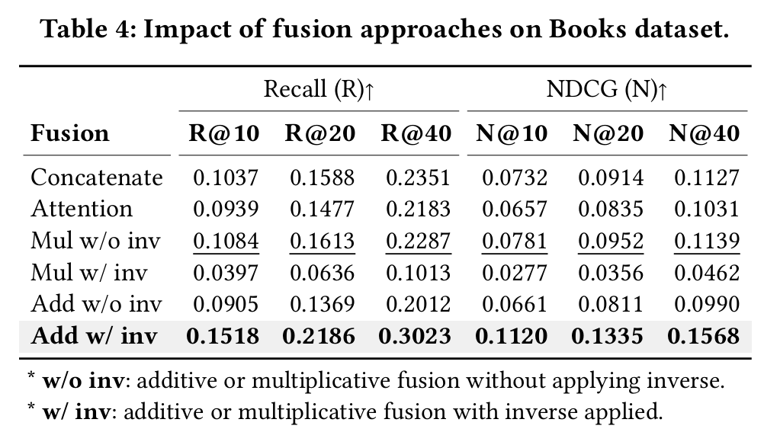
ATAI
AdvancedTechniqueof
Artificial Intelligence
ATAI
ChongqingUniversity _{AdvancedTechniqueof}
of Technology Artificial Intelligence
ChongqingUniversity of Technology
Experiments
Notes:
比较将语义融入到实体表示的几种融合方法，拼接、注意力、乘法、乘法加逆操作、加法、加法加逆操作

Slide 10
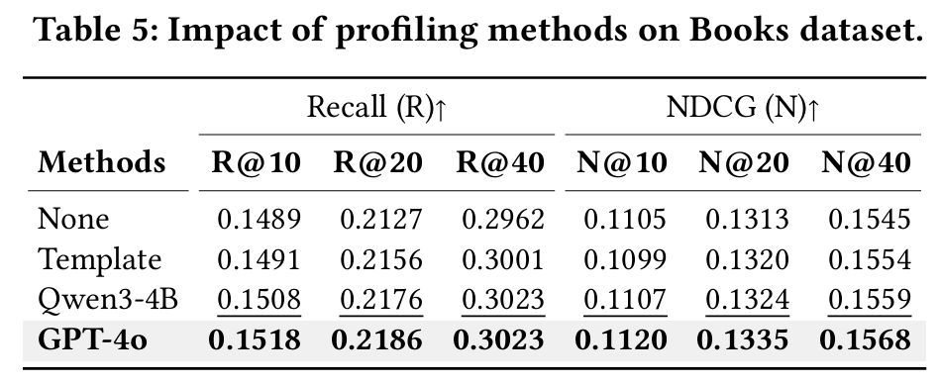
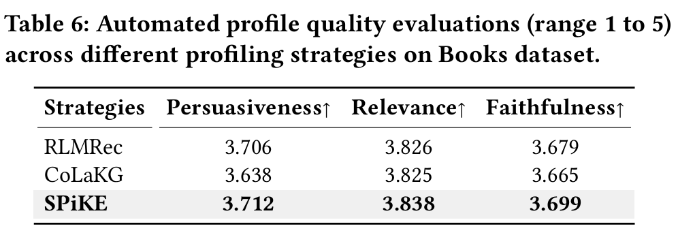
ATAI
AdvancedTechniqueof
Artificial Intelligence
ATAI
ChongqingUniversity _{AdvancedTechniqueof}
of Technology Artificial Intelligence
ChongqingUniversity of Technology
Experiments
Notes:
Table5：研究不同的profile生成方法
Table6：评估生成的profile的质量 用的GPT5 说服力、相关性和忠诚度
说服力衡量的是个人档案的表达是否具有足够的说服力，能够清楚、逻辑地表达用户的偏好，并提供足够的证据或推理来支持这些偏好。这不仅仅是描述用户的兴趣，还要求解释为何用户会产生这些偏好，或者用户选择某些物品的原因
相关性衡量的是生成的个人档案是否准确地反映了用户的实际偏好，是否能捕捉到用户行为中的重要模式。一个高度相关的档案应准确总结用户的兴趣，并将其与用户实际的行为（如观看历史、购买记录等）紧密联系
真实性衡量的是个人档案中的陈述是否与用户的真实行为和历史一致。它要求档案所表达的偏好和推理是基于真实的用户行为，并且没有虚构或错误的部分。

Slide 11
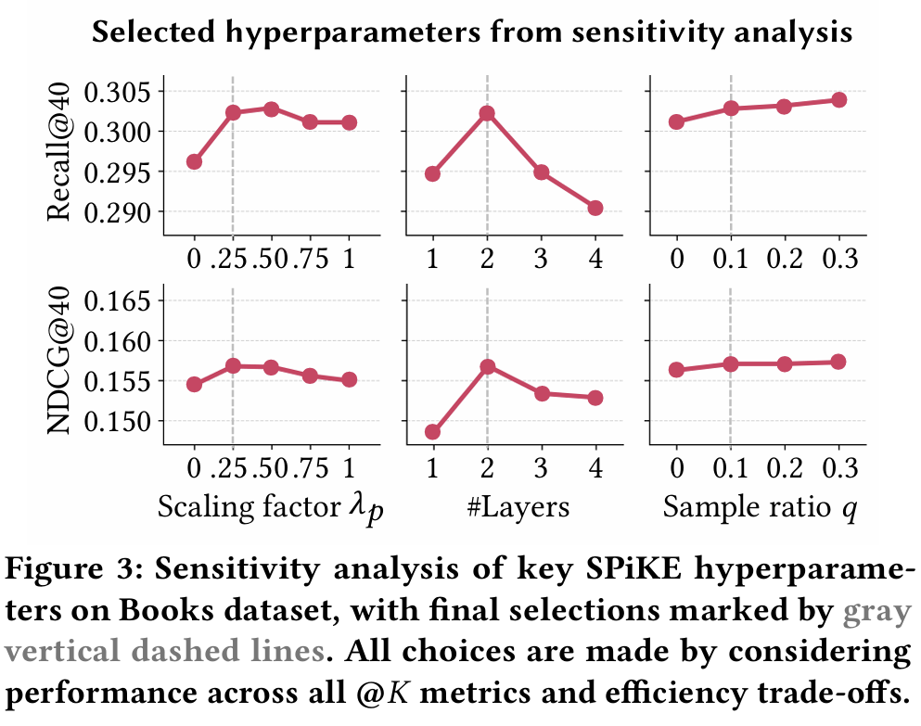
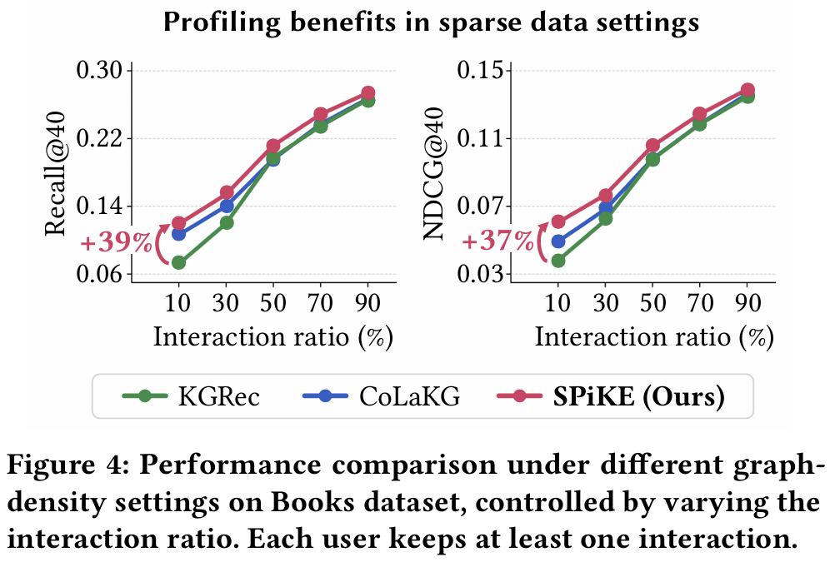
ATAI
AdvancedTechniqueof
Artificial Intelligence
ATAI
ChongqingUniversity _{AdvancedTechniqueof}
of Technology Artificial Intelligence
ChongqingUniversity of Technology
Experiments
Notes:
Figure3：参数敏感性
Figure4：稀疏场景的效果 这一结果表明，当图形连通性有限时，语义配置文件提供了额外的指导

Slide 12
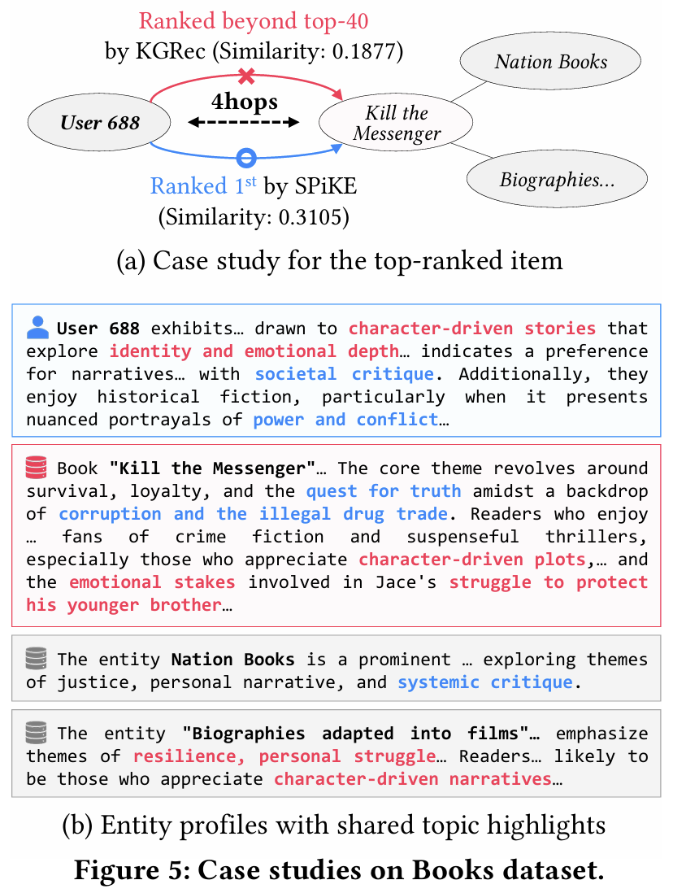
Experiments
ATAI
AdvancedTechniqueof
Artificial Intelligence
ATAI
ChongqingUniversity _{AdvancedTechniqueof}
of Technology Artificial Intelligence
ChongqingUniversity of Technology
Notes:
KGRec模型未能识别User 688的偏好，并未将这本书推荐

Slide 13


ChongqingUniversity of Technology
ATAI
AdvancedTechniqueof
Artificial Intelligence
ATAI
ChongqingUniversity _{AdvancedTechniqueof}
of Technology Artificial Intelligence
Thanks!

